Slide 1
BJT- Bipolar Junction Transistor

Slide 2
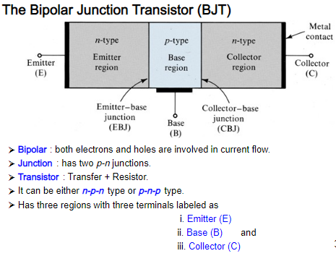

Slide 3
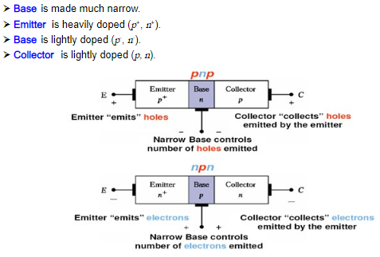

Slide 4
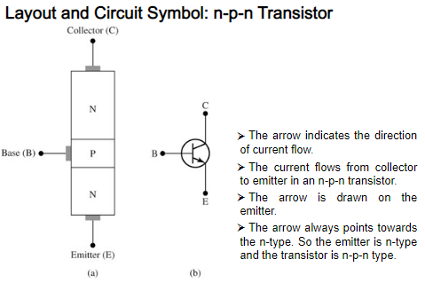

Slide 5
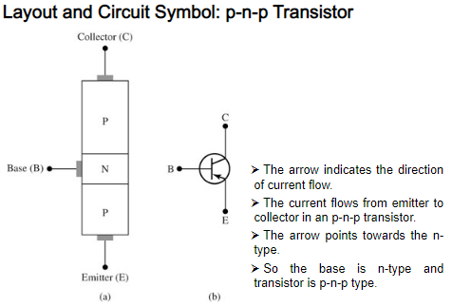

Slide 6
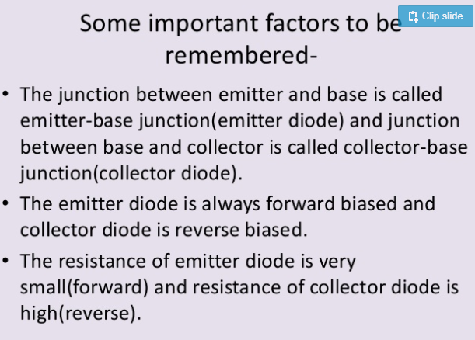

Slide 7
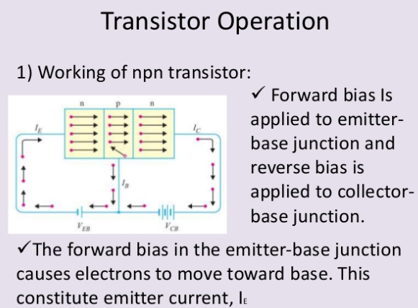

Slide 8
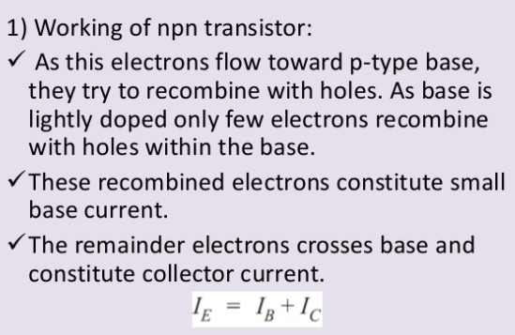

Slide 9
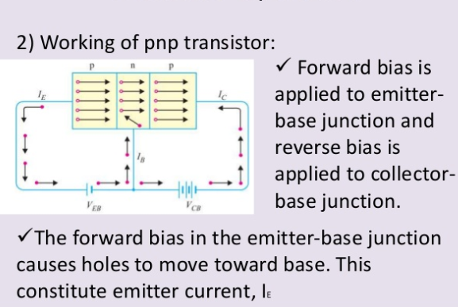

Slide 10
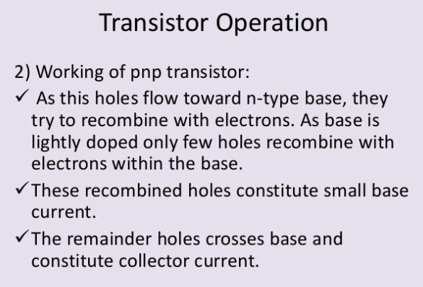

Slide 11
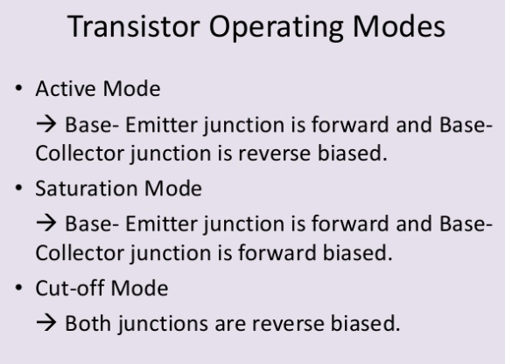

Slide 12
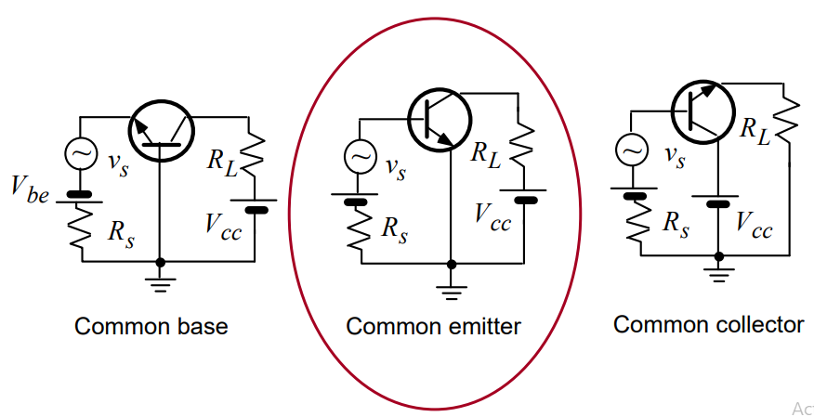
Transistor Configuration
The transistor has three terminals – emitter (E), base (B) and collector (C).
But in the circuit connections we need four terminals, two terminals for input and another two terminals for output. To overcome these problems we use one terminal as common for both input and output actions.
The behaviour of these three different configurations of transistors with respect to gain
Common Emitter (CE) Configuration: current gain and voltage gain
Common Collector (CC) Configuration: current gain but no voltage gain
Common Base (CB) Configuration: no current gain but voltage gain

Slide 13
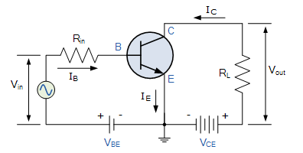
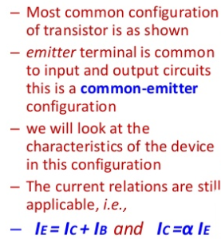
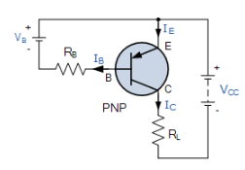
Common Emitter for NPN and PNP Transistor

Slide 14
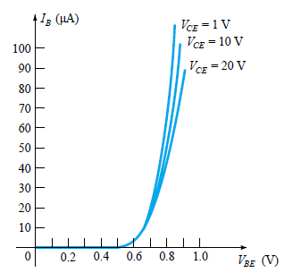
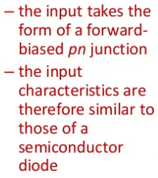
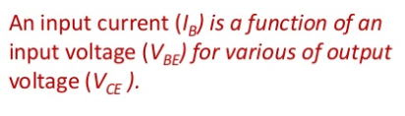
Common Emitter Input Characteristics

Slide 15
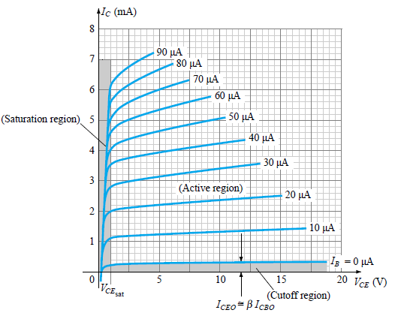
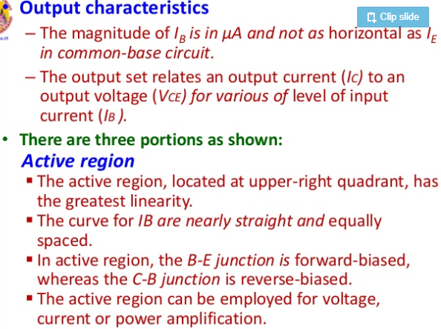
COMMON EMITTER OUTPUT CHARACTERISTICS

Slide 16
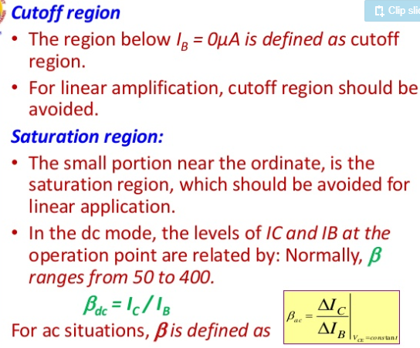

Slide 17
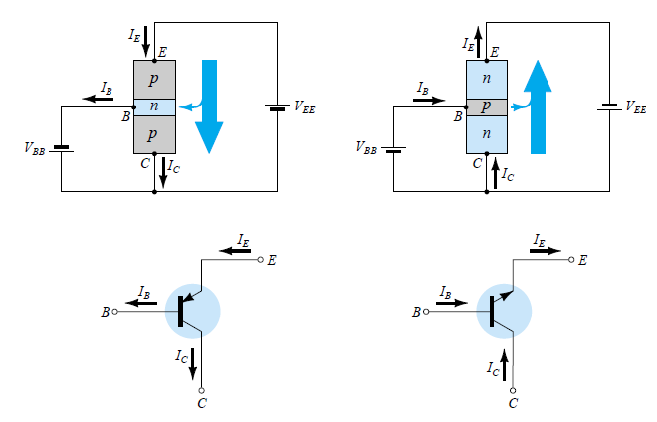
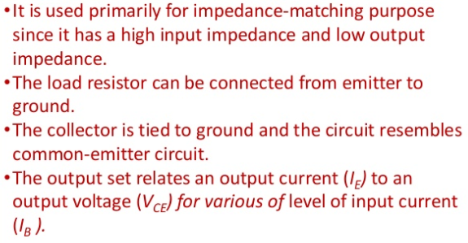
COMMON COLLECTOR FOR PNP AND NPN TRANSISTORS

Slide 18
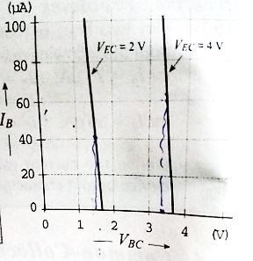
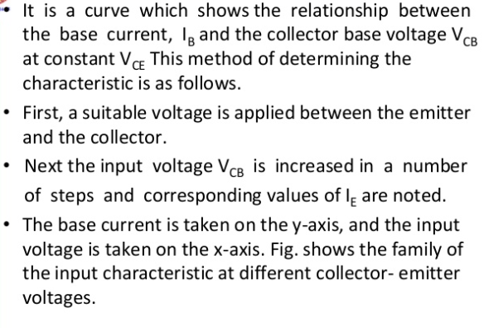
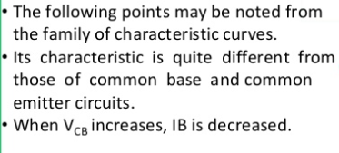
COMMON COLLECTOR INPUT CHARACTERISTICS

Slide 19
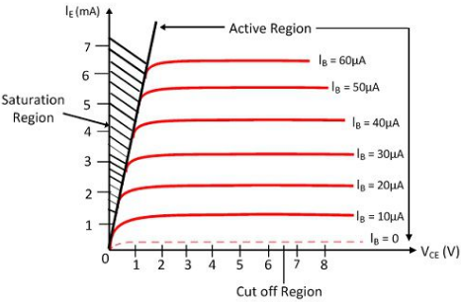
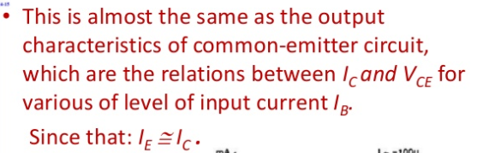
COMMON COLLECTOR OUTPUT CHARACTERISTICS

Slide 20
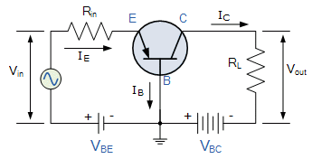
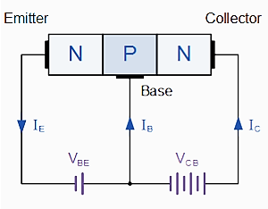
COMMON BASE FOR PNP AND NPN TRANSISTORS

Slide 21
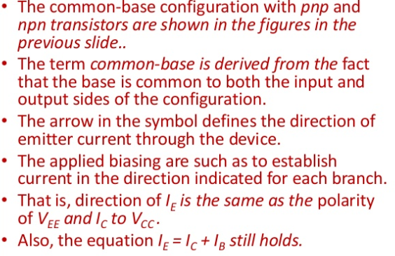

Slide 22
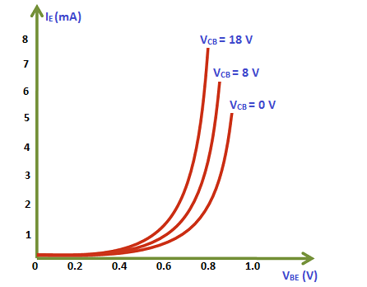
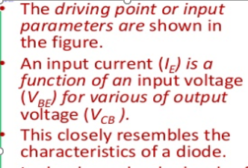
COMMON BASE INPUT CHARACTERISTICS

Slide 23
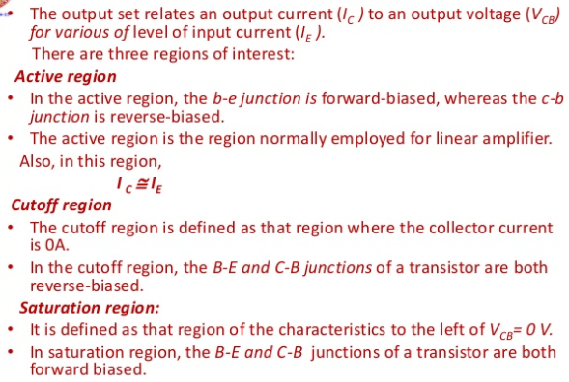
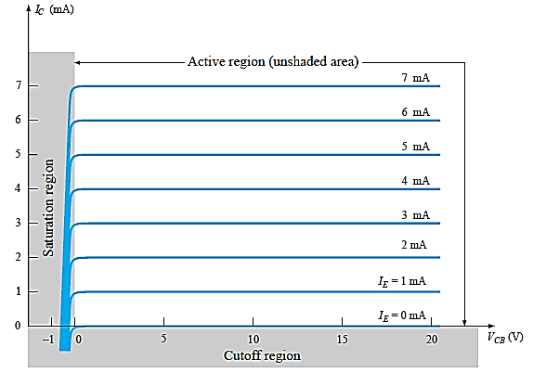
COMMON BASE OUTPUT CHARACTERISTICS

Slide 24
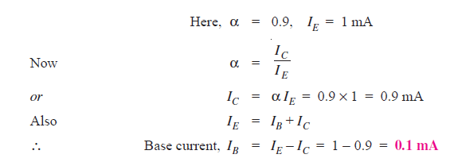
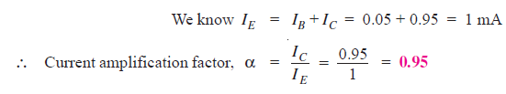
1. In a common base connection, current amplification factor is 0.9. If the emitter current is 1mA, determine the value of base current.
Solution :
2. In a common base connection, IC = 0.95 mA and IB = 0.05 mA. Find the value of α.
Solution :

Slide 25


3. In a common base connection, I_{E} = 1mA, I_{C} = 0.95mA. Calculate the value of I_{B} .
Solution :
4. In a common base connection, the emitter current is 1mA.
If the emitter circuit is open, the collector current is 50 μA.
Find the total collector current. Given that α = 0.92.
Solution :

Slide 26
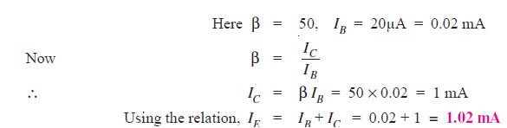
5. Calculate I_{E} in a transistor for which β = 50 and I_{B} = 20 μA.
Solution :

Slide 27
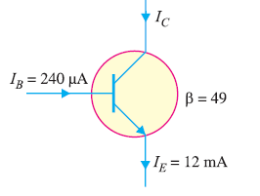
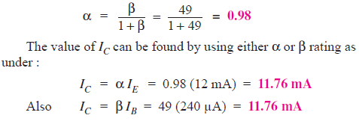
6. Find the α rating of the transistor shown in Fig. Hence determine the value of I_{C} using both α and β rating of the transistor.

Slide 28
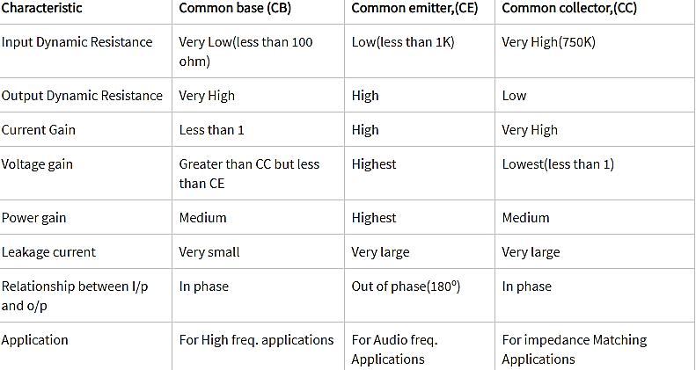
COMPARISON OF CB,CE,CC

Slide 29




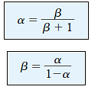
RELATIONSHIP OF α,β, γ

Slide 30
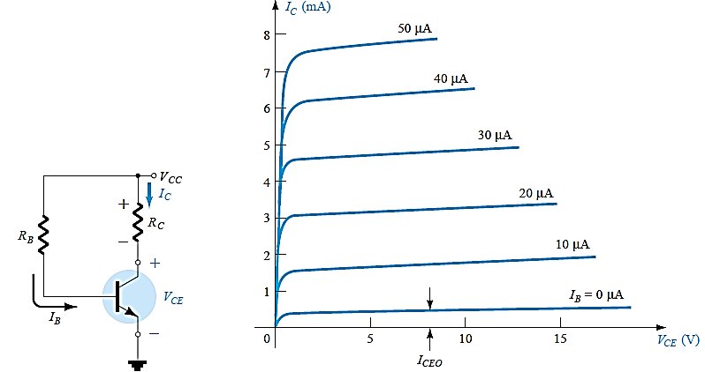
DC BIASING
Transistor Biasing is the process of setting a transistors DC operating voltage or current conditions to the correct level so that any AC input signal can be amplified correctly by the transistor

Slide 31


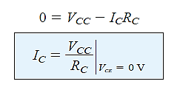
DC BIASING

Slide 32
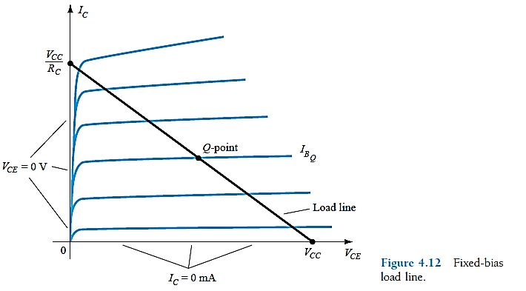
DC BIASING
The correct operating point requires the selection of bias resistors and load resistors to provide the appropriate input current and collector voltage conditions.
The correct biasing point for a bipolar transistor, either NPN or PNP, generally lies somewhere between the two extremes of operation with respect to it being either “fully-ON” or “fully-OFF” along its DC load line. This central operating point is called the “Quiescent Operating Point”, or Q-point for short.

Slide 33
Types of DC biasing
Fixed bias.
Collector-to-base bias.
Fixed bias with emitter resistor.
Voltage divider bias or potential divider.
Emitter bias.

Slide 34
Uses of BJT
The bipolar junction transistor (BJT) is used in logic circuits.
The BJT is used as an oscillator.
It is used as an amplifier.
It is used as a multivibrator.
For wave shaping, it is used in clipping circuits.
Used as a detector or demodulator.
It is also used as a modulator.
Used in timer and time delay circuits.
It is used in electronics switch.
It is used in switching circuits.

